Slide 1

Srijan bhasha
Designed to easily integrate with your existing software
Srijan Multilingual Report: A versatile solution that converts reports generated by existing software applications into Hindi or any other required regional language, enabling organizations to deliver multilingual reports without modifying their core applications.
Srijan Multilingual Bhasha: A system-installed plugin for Internet Explorer that enables users to convert the content of existing applications into the required language, supporting seamless multilingual operations.
Srijan Multilingual Passbook: A client-based multilingual solution designed to generate passbooks in the required language. The solution is delivered with complete documentation, including Installation & Configuration Manual, Customization Manual, and User Manual, along with the necessary installers.

Slide 2
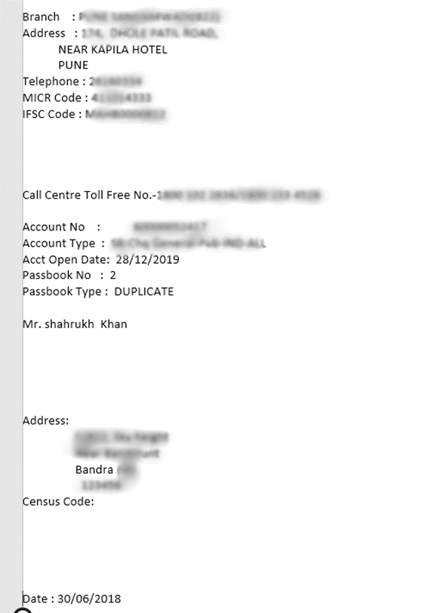
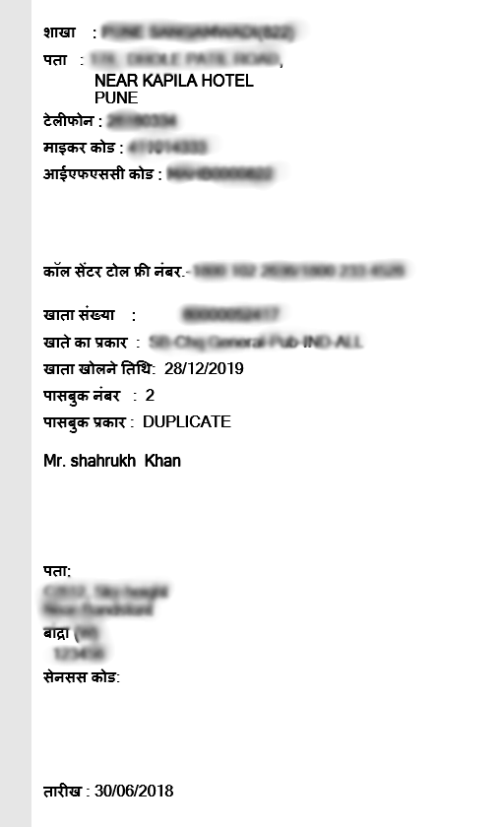
Srijan bhasha
Multilingual Passbook conversion sample of front page:

Slide 3
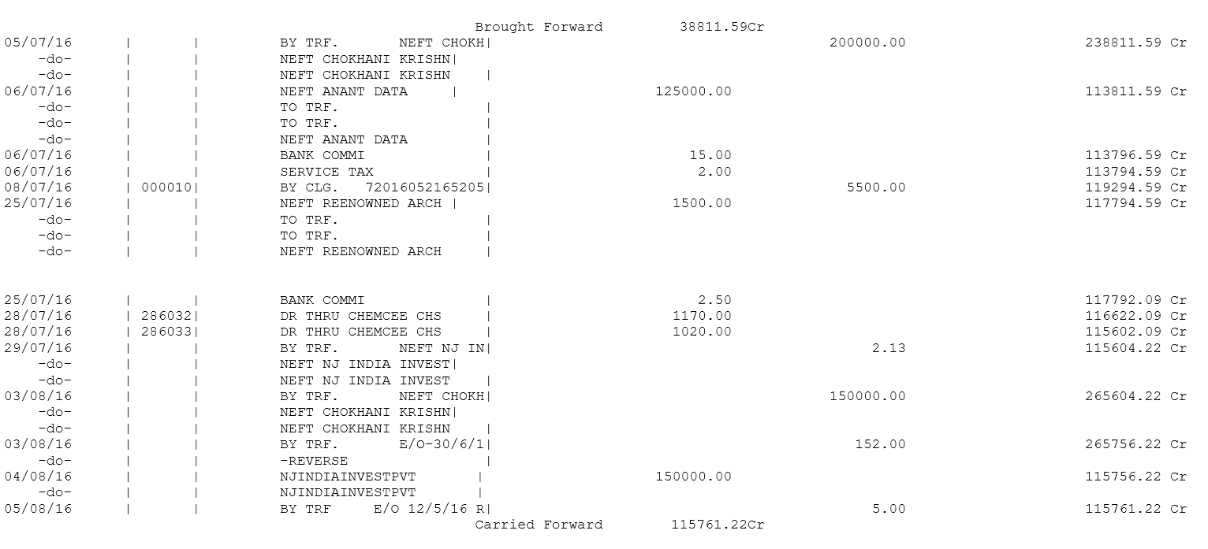
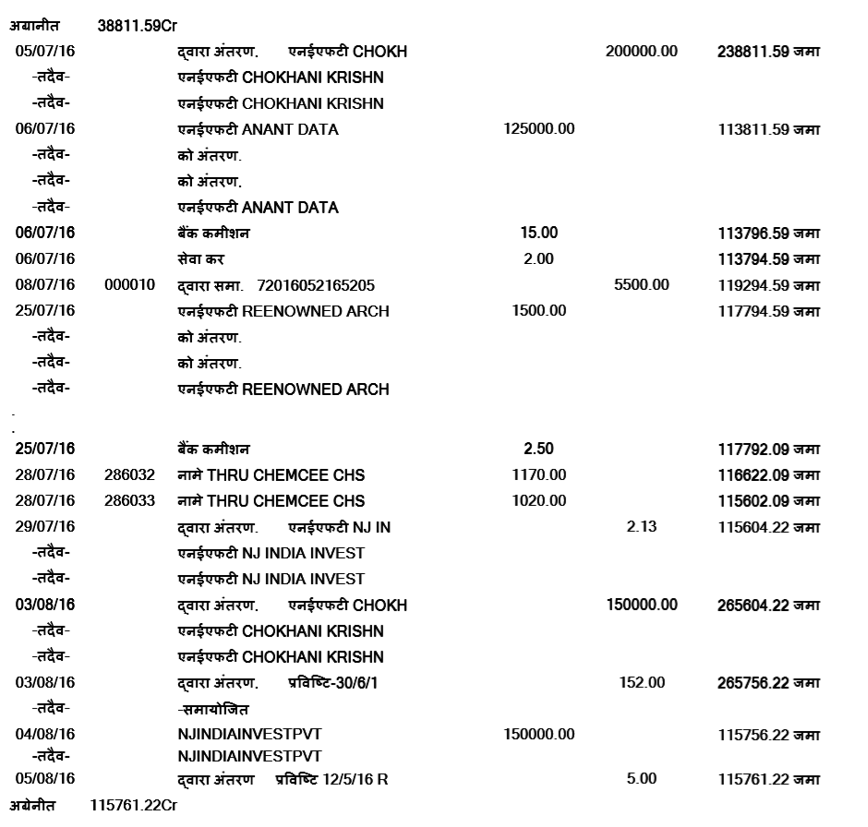
Srijan bhasha
Multilingual Passbook conversion sample of transaction page:
In English
In Hindi

Slide 4
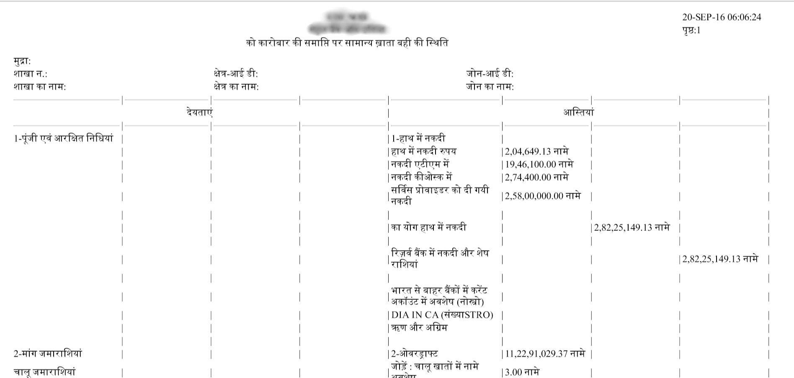
Srijan bhasha
Sample report of hindi conversion:
In English
In Hindi

Slide 5
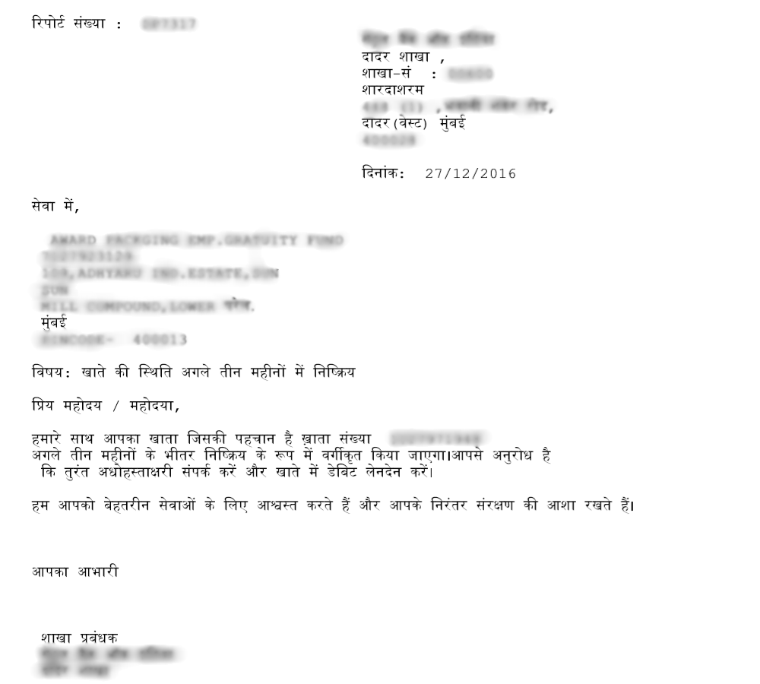
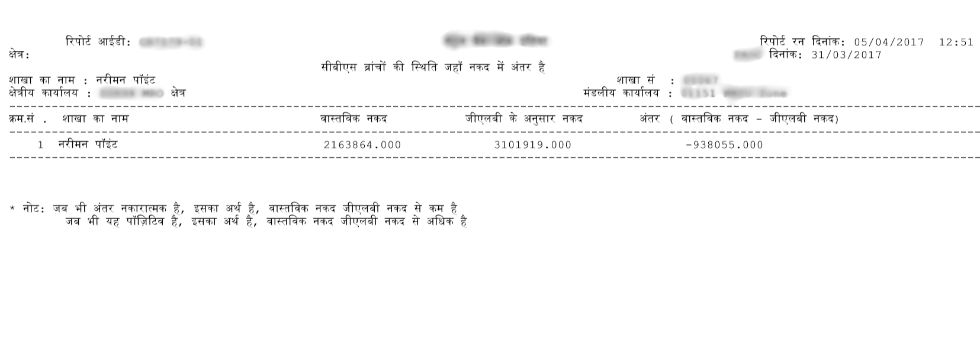
Srijan bhasha
Sample hindi conversion screens:

Slide 6
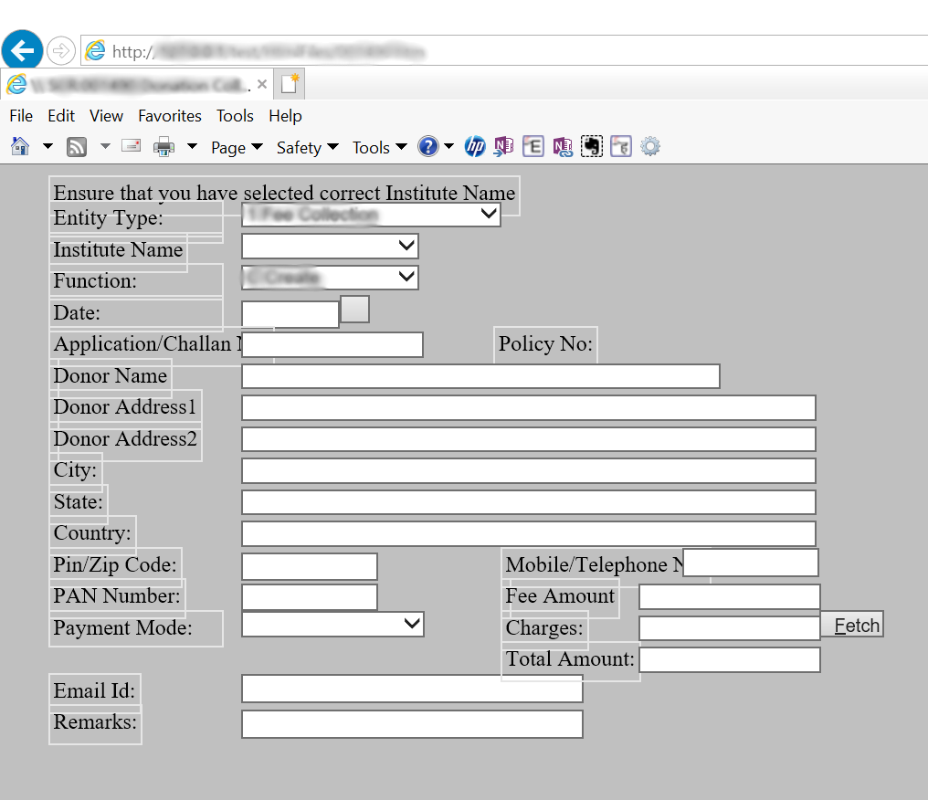
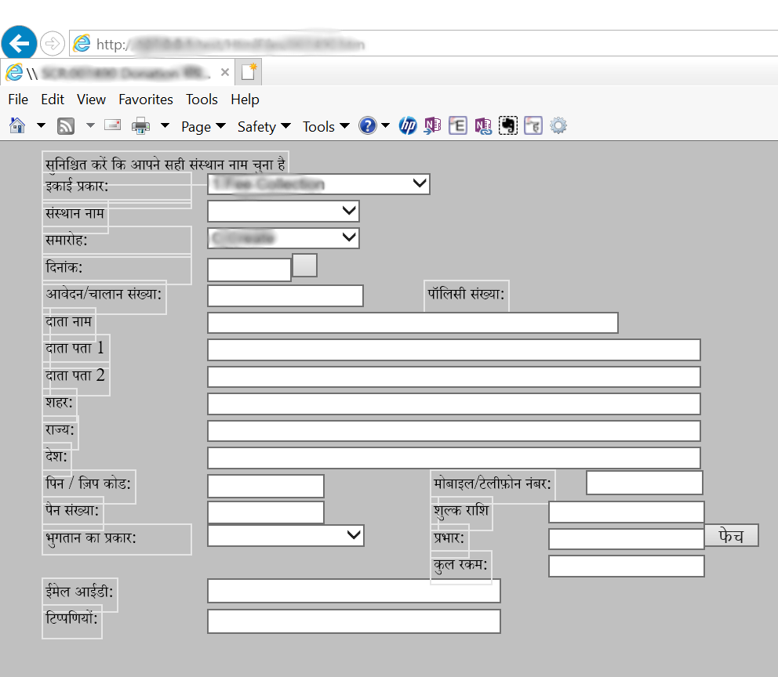
Srijan bhasha
Sample hindi conversion screens:
In English
In Hindi

