Slide 1
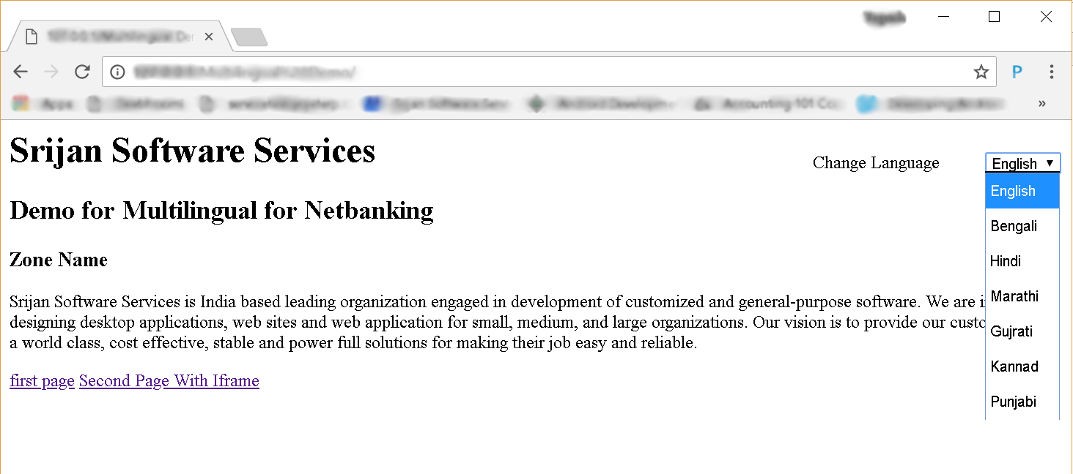
Srijan Multilingual
Your HoME PAGE : select any language from dropdown (You can add as many languages as you want)

Slide 2
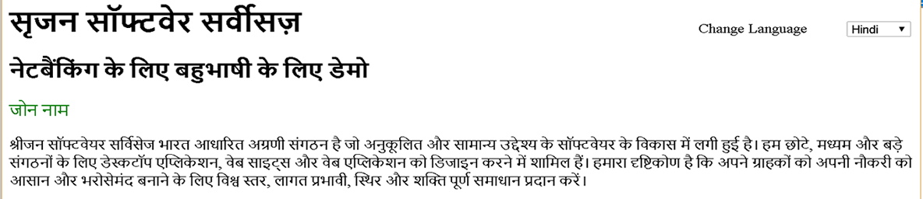
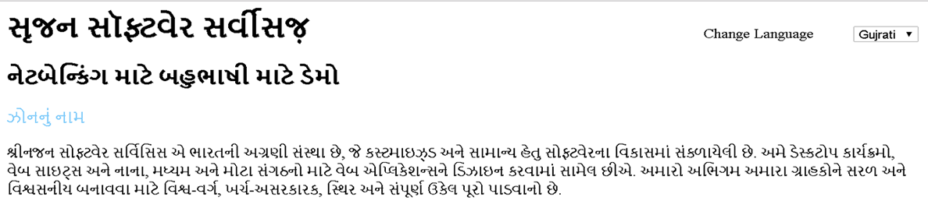
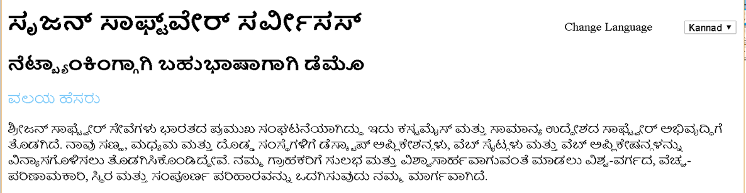
Srijan Multilingual
Results:
When you select :HINDI
When you select :GUJRATI
When you select :KANNAD

